Slide 1




Happy Life Insurance
20/20 Vision
Elizabeth Culkin | Lindsey Hume | Chris Stanko | Omkar Tamhankar

Slide 2
Agenda
Current Situation
Project Plan Overview
Authentication and Authorization
Security Controls
Operations Planning
Timeline
Breach Notification
Process Flows
Workforce Clearance
Facility Security Plan
Financial Analysis
Risks & Mitigations
Conclusion

Slide 3
Happy Life needs to comply with HIPAA to avoid risks and consequences of HIPAA related events.
Happy Life has grown exponentially in the past decade from 2 million members to currently over 40 million members. Happy Life is preparing for an IPO.
A competitor suffered a data breach and given its proximity to an IPO, Happy Life executives are worried that Happy Life is unprepared to prevent or manage a similar event.
How can Happy Life Insurance mitigate the risk of a HIPAA related event/incident to lessen the chance of a similar breach?
Current Situation | Project Plan Overview | Timeline| Breach Notification | Process Flows | Financial Analysis | Risks | Conclusion

Slide 4
By implementing the Security Safeguard Implementation Plan, Happy Life will be HIPAA compliant.
Operations Planning
Cybersecurity
Authorization and Authentication
Incident Response
Risk Management
Security Controls
Vendor Assessment and Management
Current Situation | Project Plan Overview | Timeline| Breach Notification | Process Flows | Financial Analysis | Risks | Conclusion

Slide 5
Authorization and Authentication
User Authorization Request
Workforce members receive unique user ID
Workforce members’ manager must request access to EPHI
Approval/Denial
IT Security Manager reviews request and approves/denies access. This includes verifying Segregation of Duties is upheld
If approved, the Application Manager will approve/deny access.
If both approve, access is automatically granted
Enforce
Authenticate user identity when using the application through unique user ID and ID badge
Once authenticated, approve the user to use the system
Removal
Upon the ending of employment for a workforce member, HR Representative informs IT Security Manager
IT Security Manager removes all access for former member
Audit
Inspect EPHI access each quarter and cross-reference with Segregation of Duties
Review
Check and verify EPHI access every quarter
Reconcile
Implement access controls in systems to match access with user access
User Authorization Request
Approval / Denial
Enforce
Audit
Review
Reconcile
Removal
Current Situation | Project Plan Overview | Timeline| Breach Notification | Process Flows | Financial Analysis | Risks | Conclusion

Slide 6
Authorization and Authentication RACI Matrix
Role/Responsibilities | IT Security Manager | Application Manager | Workforce Member | Manager | HR Representative | VP of IT
Workforce members receive unique user ID |  |  | I | A | R
Request access to EPHI | I | I | A | R |  | I
Review EPHI request and approve/deny access | R | A | I | C | I | I
Authenticate user identity when using the application | A |  | R
Inform ending of employment for a workforce member | I |  |  | A | R | I
Inspect EPHI access each quarter and cross-reference with SoD | R | A |  |  |  | I
Check and verify EPHI access every quarter | R | A | I | I | I | I
Implement access controls in systems to match access with user access |  | R |  |  |  | A
Current Situation | Project Plan Overview | Timeline| Breach Notification | Process Flows | Financial Analysis | Risks | Conclusion

Slide 7
Security Controls
Identify
Allocate monitoring responsibilities to security personnel
Require performance training for users authorized to access EPHI workstations
Authenticate
Application Development team with guidance from IT Security implements an automated application to corroborate EPHI
Require physical access to the facility through ID badges
Require duo authentication when accessing EPHI
Monitor
Implement alarms and cameras for monitoring
Record all facility maintenance repairs
Occurrences of 5 failed log-in attempts results in automatic notification to the IT Security team and requirement of user to reset password
Application Development team implements a mechanism to record activity and timestamps for all information systems
Require passwords to be 10 characters in length, with a combination of letters, numbers, and special characters. Passwords are required to change monthly
Terminate user sessions after one minute of inactivity
Review
Generate weekly automated information systems access reports, audit logs, and & tracking records
Evaluate security policies and procedures each quarter to verify EPHI security
Identify
Authenticate
Monitor
Review
Current Situation | Project Plan Overview | Timeline| Breach Notification | Process Flows | Financial Analysis | Risks | Conclusion

Slide 8
Security Controls RACI Matrix
Role/Responsibilities | IT Security Manager | IT Security Team | Workforce Member | IT Application Team | Director of Application Development | VP of IT
Allocate monitoring responsibilities to security personnel | R | I |  |  |  | A
Require performance training for users authorized to access EPHI workstations | A | R | I
Implement an automated application to corroborate EPHI | C | C |  | R | A | I
Require physical access to the facility | A | R | I
Require duo authentication when accessing EPHI | A | R | I
Implement alarms & cameras for monitoring | A | R | I
Record all facility maintenance repairs | A | R |  |  |  | I
Occurrences of 5 failed log-in attempts requires password reset | A | I | R
Implement a mechanism to record activity & timestamps for all information systems |  | C |  | R | A
Password requirements | A | R | I | I | I | I
Evaluate security policies and procedures each quarter to verify EPHI security | A | R |  |  |  | I
Current Situation | Project Plan Overview | Timeline| Breach Notification | Process Flows | Financial Analysis | Risks | Conclusion

Slide 9
Operations Planning
Plan
Outline scope for contingency plan, facility access controls, device and media controls, and access controls
Develop project plan & charter for BCM
Compliance offers from each location will determine governance routines and standards
Identify resources necessary and available in order to maintain business continuity and EPHI security
Assess & Validate
Risk Based Prioritization
Business Process Identification & Initial Prioritization
Business Impact Analysis
Dependency Analysis
Recovery Gap Analysis
Site Risk Assessment
Design
Design strategy to recover exact copies of EPHI after a breach or data loss
Implement
Strategy Implementation
Disaster Recovery & Resiliency Plan
Business Continuity Plan
Incident Response Plan
Exercise
Test contingency plan, facility access controls, device and media controls, and access controls
Simulate and test each set of controls
Sustain & Maintain
Training & Awareness
Plan regular HIPAA compliance audits
Plan
Assess & Validate
Design
Implement
Exercise
Sustain & Maintain
Current Situation | Project Plan Overview | Timeline| Breach Notification | Process Flows | Financial Analysis | Risks | Conclusion

Slide 10
Operations Planning RACI Matrix
Role/Responsibilities | VP of IT | Director of Compliance | IT Security Manager | 20/20 HIPAA Expert
Outline scope for contingency plan, facility access controls, device and media controls, and access controls | A | I | C | R
Develop project plan & charter for BCM | I | A | C | R
Compliance offers from each location will determine | I | A | R | C
Identify resources necessary and available in order to maintain business continuity and EPHI security | I | R | A | C
Risk Based Prioritization | A | R | C | I
Business Process Identification & Initial Prioritization | R | A | I | C
Business Impact Analysis | A | I | C | R
Dependency Analysis | A | I | C | R
Recovery Gap Analysis | A | I | C | R
Site Risk Assessment | A | I | C | R
Design strategy to recover exact copies of EPHI after a breach or data loss | I | A | R | C
Strategy Implementation | R | C | I | A
Disaster Recovery & Resiliency Plan | I | A | C | R
Business Continuity Plan | I | A | C | R
Incident Response Plan | I | A | C | R
Test contingency plan, facility access controls, device and media controls, and access controls | C | I | R | A
Simulate and test each set of controls | C | I | R | A
Training & Awareness | I | R | C | A
Plan regular HIPAA compliance audits | I | A | C | R
Current Situation | Project Plan Overview | Timeline| Breach Notification | Process Flows | Financial Analysis | Risks | Conclusion

Slide 11
Security Safeguard Timeline
 | Month 3 | Month 6 | Month 9 | Month 12 | Month 15 | Month 18 | Month 21 | Month 24 | Month 27
Assign Director of Compliance | Assigned at Initiation of Case
HIPAA Safeguard Risk Analysis
Project Plan Requirements Gathering
Project Plan Scoping
Project Plan Implementation
Project Plan Ongoing Audit
Current Situation | Project Plan Overview | Timeline| Breach Notification | Process Flows | Financial Analysis | Risks | Conclusion
Notes:
https://webcache.googleusercontent.com/search?q=cache:_EAeftIgVMIJ:https://www.securitymetrics.com/blog/what-hipaa-compliance-and-how-long-will-it-take+&cd=11&hl=en&ct=clnk&gl=us : “Medium-sized organizations are difficult to estimate, because they vary so much in size. But generally, from beginning to end, HIPAA will likely take you 1-2 years.”

Slide 12
In the event of a data breach, Happy Life will follow this breach notification process.
Discover Breach
Notify Affected Individuals (Notification to Patients)
10 or more (Substitute Notice and Media Notification)
Less than 500 (HHS Notification)
500 or more (Media Notification and HHS Notification)
Insufficient Contact Information
Less than 10 (Substitute Notice)
Total Number of Affected Individuals
Conduct Risk Assessment
Notification to Patients (Email or Letter)
Sent within 60 days of discovery
Will include:
Description of the breach
Description of the types of information involved with the breach
Steps breach victims should take to protect themselves from harm
Description of what Happy Life is doing to investigate the breach, mitigate the harm, and prevent further breaches
Happy Life contact information
Substitute Notice
Post a notice on Happy Life website homepage for at least 90 days
Set up a toll-free number that remains active for at least 90 days where victims can receive information about the breach
Media Notification
Sent within 60 days of discovery
Will include:
Same information as Notification to Patients
Department of Health and Human Services Notification:
Less than 500 individuals
Notify Secretary of the breaches on an annual basis; Report of breaches due within 60 days after the end of the calendar year in which the breaches are discovered
More than 500 individuals
Notify Secretary immediately and in no case later than 60 days following the breach by filling out and electronically submitting a breach report form
Current Situation | Project Plan Overview | Timeline| Breach Notification | Process Flows | Financial Analysis | Risks | Conclusion

Slide 13
By establishing roles and responsibilities for when breaches occur, Happy Life will be able to notify the necessary parties involved with minimal issues.
Role/Responsibilities | Privacy | CIO | CISO | Media Relations | Legal
Discover & Declare a Breach | RC | I | IC | I | A
Assess Impact of Breach | R | I | R | IC | A
Draft & Send Out Impacted Individual Notification Message(s) | RCI | I | I | RCI | A
Notify the Media | CI | CI | CI | R | I
Notify the Secretary of the Health and Human Services | CI | CI | CI | I | R
Note: We were given minimal information in terms of organizational structure of the company, so we assumed that the company has a CISO, Media Relations team, Legal team, and Privacy team.
Current Situation | Project Plan Overview | Timeline| Breach Notification | Process Flows | Financial Analysis | Risks | Conclusion

Slide 14
By following breach preventative measures, Happy Life will be prepared if a future breach were to occur.
Preparation – All staff members must know their roles and responsibilities. Establish breach response plan (test and try)
Detection – Networks need to be routinely and regularly scanned for potential breaches. Notify law enforcement agencies.
Identification – Know the enemy (who, where, what, why) to determine best method for isolating/neutralizing the threat.
Isolation – Shut down all compromised systems to contain the attack/infection. Stop data access immediately, try to prevent the exfiltration of PHI. Check all systems and equipment and determine if other areas have been compromised.
Eradication – Ensure a data backup has been performed. Prevent data loss. Complete a thorough system disinfection. All back doors/other entrances must be found and shut down immediately.
Investigation – Conduct forensic data analysis to find out how the data was exposed and the extent of the attack. Seek assistance from external data security exports and perform a thorough risk assessment to identify new security vulnerabilities that may exist.
Notification – Issue breach notification letters within 60 days to victims and report the breach to the OCR immediately.
Fortification – Plug all security holes and fortify data security defenses. Notify government regulatory members of security vulnerabilities that were addressed immediately following the PHI breach. Note: A data breach may not warrant a HIPAA fine, but failure to address security risks will.
Preparation – Prepare for potential upcoming attacks. Assess which elements of the breach response worked well and what didn’t. Make updates, develop new policies and procedures, and test them to ensure they work.
Fortification
Preparation
Detection
Identification
Isolation
Eradication
Investigation
Notification
Current Situation | Project Plan Overview | Timeline| Breach Notification | Process Flows | Financial Analysis | Risks | Conclusion

Slide 15
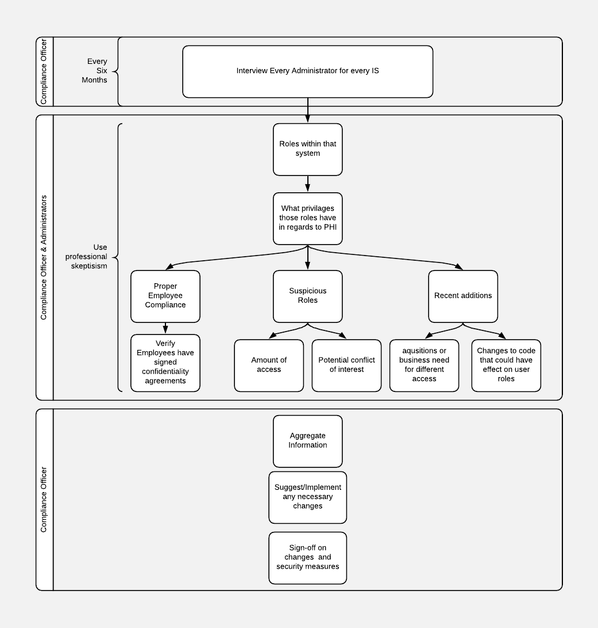
Workforce Clearance Procedure
Walkthrough
Every six months the compliance officer interviews every administrator for every Information System
Discuss the roles within that system and their respective privileges regarding the access of ePHI
Compliance officer needs skeptical approach to user access
This audit is completed before the user access log audit
Red flags will naturally appear to compliance officer if they have recently audited the roles vs. what is occurring
Any suspicious activity or anomalies are documented and discussed with the specific administrator and compliance team of that IS
If necessary, interview specific employees with suspicious roles to understand how they are using their access
Document any observations for future audit of actual user access logs
Store assessment as a starting point for next audit
Current Situation | Project Plan Overview | Timeline| Breach Notification | Process Flows | Financial Analysis | Risks | Conclusion

Slide 16
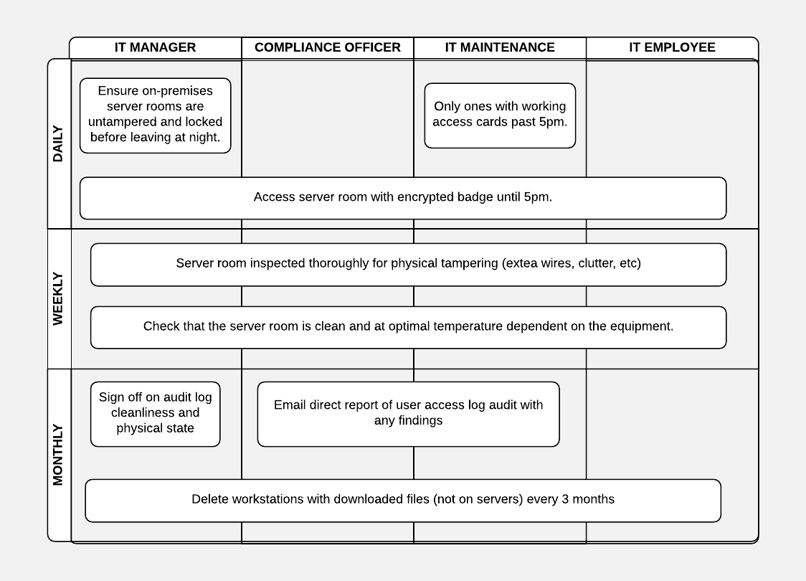
Facility Security Plan
Walkthrough
Manager assigned to ensure on-premises server rooms w/ePHI are untampered and locked before leaving for the night
Server rooms are locked during the day and can be only accessed by encrypted electronic badge
After 5pm, the only access cards that work are the IT maintenance staff
Server room user access log is audited monthly
Compliance officer/IT maintenance will sign-off by sending an email to direct report of user access log being auditing with any findings
On a weekly basis, the server room with ePHI will be inspected thoroughly for any physical tampering (extra wires, clutter, etc.)
Server room is clean and at an optimal temperature dependent on the specifications of the equipment used
With the server room log audit, the individual in charge, will also sign-off on its cleanliness and physical state
All workstations with downloaded files, not on servers, will be deleted every 3 months
This discourages ePHI being on desktops, mobile devices, etc.
More importantly encourages the storage of data being on the business's servers
Current Situation | Project Plan Overview | Timeline| Breach Notification | Process Flows | Financial Analysis | Risks | Conclusion

Slide 17
Financial Analysis
 | Year 0 | Year 1 | Year 2 | Year 3 | Year 4 | Year 5
Training Security Personnel | $ 19,600
Software Dev (Charge-back) | $ 241,920
DUO Authentication (Yearly) | $ 194,400 | $ 194,400 | $ 194,000 | $ 194,000 | $ 194,000 | $ 194,000
Alarms & Cameras | $ 50,000 | $ 5,000 | $ 5,000 | $ 5,000 | $ 5,000 | $ 5,000
Active Directory (Charge-Back) | $ 30,240
BIA (Breach) | $ 12,000
Continuous IS Updates | $ 252,000 | $ 12,000 | $ 12,000 | $ 12,000 | $ 12,000 | $ 12,000
Vendor Categorization | $ 75,600
Compliance Team | $ 1,800,000
Total Cost | $ 2,675,760 | $ 211,400 | $ 211,400 | $ 211,400 | $ 211,400 | $ 211,400
NPV | $ 3,554,270.63
Potential Breach Savings | $ 9,500,000.00
Savings from Implementation with Breach | $ 5,945,729.37
$5.9 Million Potential Savings from implementation with breach
-$3.5 Million NPV after implementation
Average HIPAA Breach $9.5 Million in total costs
~ $380 average cost per record (2019 Biz4Solutions)
25,000 average records exposed in a HIPAA breach (2019 Hipaajournal)
Discount Rate: 6.5%
Current Situation | Project Plan Overview | Timeline| Breach Notification | Process Flows | Financial Analysis | Risks | Conclusion
Notes:
https://duo.com/pricing
https://www.biz4solutions.com/blog/hipaa-compliant-app-development-cost-2019/

Slide 18

Happy Life will mitigate the main risks of their organization by implementing projects to become HIPAA compliant.
Risks | Mitigations
1. Customer data breach | Security Controls, Cybersecurity, and Authorization & Authentication
2. Third-party security failure | Vendor Assessment & Management
3. Reputational risk | Breach Notification Process & Risk Management
4. Unauthorized access leading to fraud | Authorization & Authentication
5. Loss of data | Incident Response Governance & Operations Planning
6. Disruption of normal business flow | Operations Planning & Incident Response
1
4
5
Impact
3
2
6
Likelihood
Current Situation | Project Plan Overview | Timeline| Breach Notification | Process Flows | Financial Analysis | Risks | Conclusion

Slide 19


Through the successful implementation of a 7-phase plan, Happy Life can be HIPAA compliant, gain confidence for a future IPO, and respond quickly to a security breach.
Early Success
Built on deep, trusted customer relationship
Lowest “drop-out” rate of any major health insurance provider
20/20 Vision
Security Safeguard Implementation Plan
Successful IPO
Secure investor confidence
Secure strong base for international expansion
Safeguard Process Flows
Breach notification process
Security Safeguard Implementation Plan
Authorization & Authentication
Security Controls
Operations Planning
Cybersecurity
Vendor Assessment & Management
Incident Response
Risk Management
Current Situation | Project Plan Overview | Timeline| Breach Notification | Process Flows | Financial Analysis | Risks | Conclusion

Slide 20
Appendix
Assumptions
Mappings of HIPAA Safeguards to Projects
Additional Projects
Cybersecurity
Risk Management
Incident Response (Operational Components)
Incident Response (Framework Components)
Vendor Assessment & Management
Cost Breakdown
Additional Process Flows
Disposal of PHI & ePHI
Information System Activity Review
Protection from Malicious Software
Data Backup Plan
Emergency Access Procedure
Automatic Log Off Procedure
Encryption and Decryption
Person or Entity Authentication
Integrity Controls

Slide 21
Assumptions
Happy Life Insurance already has a server on premise and has their own server off-premise for data backups
There is already physical access (ID readers on server doors)
There is a ratio of 1:18 IT employees to total employees
Assuming total number of employees = 2,700
Automated tasks within a project are not a part of the RACI chart due to the automation

Slide 22
One-to-One
Mapping of
HIPAA Safeguards
to Projects

Slide 23
Cybersecurity
Update
Authorize automatic security updates to all information systems
Protect
IT Security team implements safeguards for information systems to protect, detect, and report malicious software
Encrypt and decrypt EPHI through the matching of a public and private key
Remove
Implement protocol to dispose EPHI from hardware and electronic media. After disposal, verify information is not accessible on the hardware/electronic media or any other system
Monitor
Produce audit reports for use of hardware and electronic media
Update
Protect
Remove
Monitor

Slide 24
Cybersecurity RACI
Role/Responsibilities | IT Security Manager | IT Security Team | Workforce Member | IT Application Team | Director of Application Development | VP of IT
Authorize automatic security updates to all information systems | R | I | I | I | C | A
Implement safeguard for information systems to protect, detect, & report malicious software | A | R |  | I | C | I
Encrypt and decrypt EPHI through the matching of a public and private key | A | R |  |  |  | C
Implement protocol to dispose EPHI from hardware & electronic media. After disposal, verify information is not accessible on the hardware/electronic media or any other system | A | R | I |  |  | C
Produce audit reports for use of hardware & electronic media | A | R | I |  |  | I

Slide 25
Risk Management
Assess
Identify, categorize, and analyze all potential risks in dealing with EPHI
Manage
IT Security team implements measures to mitigate risks. Many of these will be implemented through other projects, such as disposing properly of EPHI, password requirements, and physical security measures.
Enforce
Explain potential risks to workforce members and require members to meet risk requirements. If compliance is not upheld, members will first be warned and then fired upon a second offense.
Assess
Manage
Enforce

Slide 26
Risk Management RACI
Role/Responsibilities | IT Security Manager | IT Security Team | Workforce Member | IT Application Team | Director of Application Development | VP of IT
Identify, categorize, & analyze all potential risks in dealing with EPHI | A | R | I | I | C | A
Implement measures to mitigate risks | A | R |  | C | C | I
Explain potential risks to workforce members & require members to meet risk requirements | A | R | I

Slide 27
Incident Response Operational Components
Identification
Containment
Resolution
Follow-up
Recovery
Identification
Identify the event or incident and what business or data component is affected
Document security incidents
Containment
Plan for isolating area of affected business or data component and minimize impact
Resolution
Resolve source of incident from the isolated area of impact
Recovery
Breach notification process
Return business areas affected back to normal operation
Follow-up
Post-mortem analysis to improve and review lessons learned
Document security incident outcomes

Slide 28
Incident Response Framework Components
Management Optics
Measurement
Governance
Maintenance
Management Optics
Historical metrics-based reporting and forward-looking predictive indicators
Measurement
Program effectiveness monitoring
Governance
Overall direction and authority
Maintenance
On-going maintenance and improvement

Slide 29
Incident Response RACI
Role/Responsibilities | IT Security Manager | IT Security Team | IT Operations Team | IT Operations Manager | VP of IT | Director IT Architecture | Director of Compliance
Identify event or incident & what business or data component is affected | A | R | I | I | I | I
Document security incidents | A | R | I | I | I | I
Plan for isolating area of affected business or data component & minimize impact | A | R | I | C | C | C
Resolve source of incident from the isolated area of impact | A | R |  | C | C | C
Breach notification process | C |  |  |  | A |  | R
Return business areas affected back to normal operation |  |  | R | A | C
Post-mortem analysis to improve & review lessons learned | A | R | C | C | I
Document security incident outcomes | A | R |  | I | I | I | I
Historical metrics-based reporting & forward-looking predictive indicators |  |  | R | A | I |  | I
Program effectiveness monitoring | C |  |  | C | A |  | R
Overall direction & authority | R |  |  |  | C |  | A
On-going maintenance & improvement | A | R | C | C | I |  | I

Slide 30
Vendor Assessment & Management
Identify
Notify
Assess
Remediate
Monitor
Identify
Generate a list off all current vendors
Categorize vendors
Notify
Inform of potential new vendors
Assess
Interview vendors
Determine likelihood of a security incident & potential impact
On-site assessments of selected vendors
Report
Remediate
Communicate discrepancies to vendors
Monitor
Maintain vendor requirements

Slide 31
Vendor Risk Management RACI
Role/Responsibilities | IT Security Manager | IT Security Team | IT Operations Team | IT Operations Manager | VP of IT
Generate a list of all current vendors | I | I | R | A | I
Categorize vendors | I | I | R | A | I
Inform of potential new vendors | I | I | R | A | C
Interview vendors | I | I | R | A | I
Determine likelihood of a security incident & potential impact | A | R | I | I | I
Report | I | I | R | A | I
Communicate discrepancies to vendors | I | I | R | A | I
Maintain vendor requirements | C | I | R | A | C

Slide 32
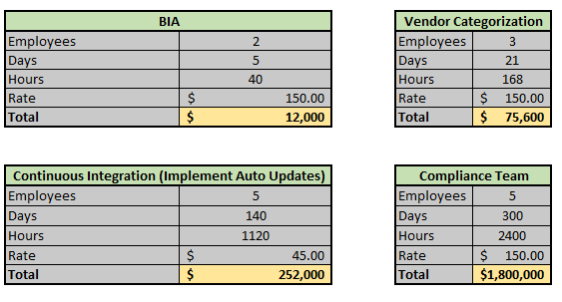
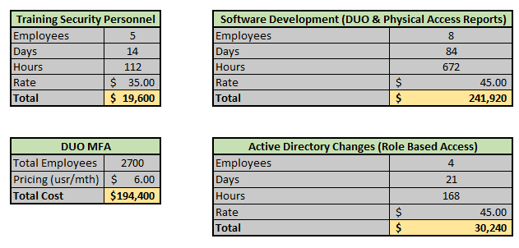
Cost Breakdown

Slide 33
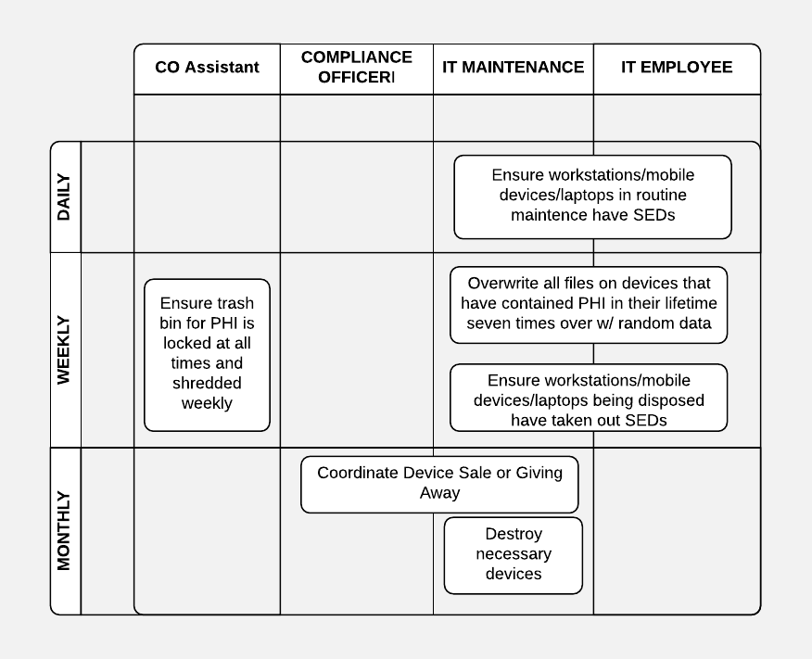
Disposal of PHI & ePHI
Walkthrough
Workplace devices use self-encrypting drives (SEDs)
File encryption is always on and does not allow user to turn it off
Every user device is checked every six months by IT manager
This will consist of checking a certain number of devices everyday by multiple people. (Simple task 20min/day)
Can be remote with sharing screen and remote access
When workplace devices are replaced:
Old workstations are wiped by either:
IT compliant standards
Replaced hard drives
Mobile devices are wiped by either:
IT compliant standards
Destroyed
Electronic Printers are wiped by either:
IT compliant standards
Destroyed
After wipe, the device’s hard drive (HDD or SSD) is completely inspected and it can be disposed, donated, sold, or destroyed
Physical paper PHI is disposed in a locked container and shredded weekly by Compliance Officer’s assistant

Slide 34
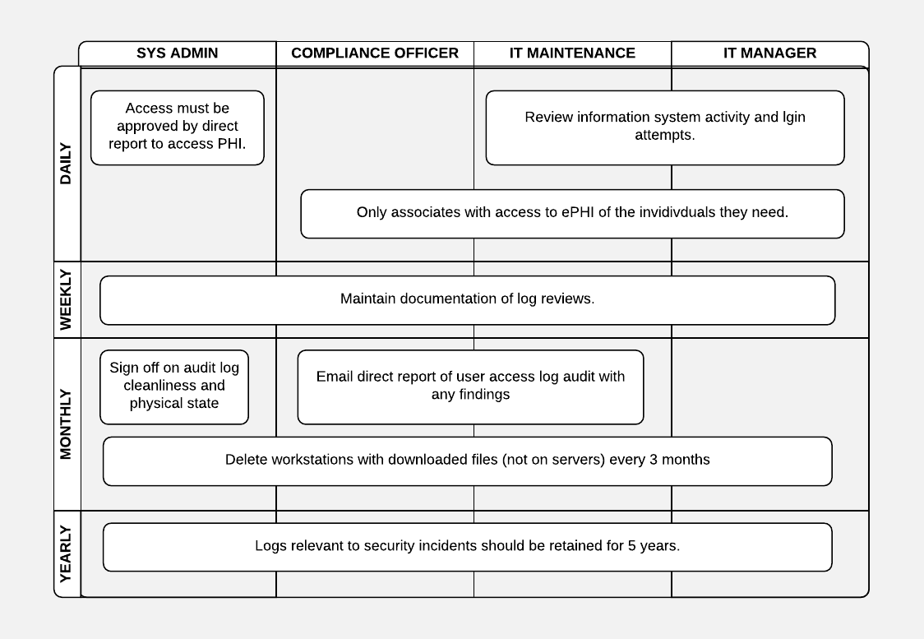
Information System Activity Review
Walkthrough
User Access Reviews
Newly hired compliance officer & team regularly review information system activity and login attempts.
Document and dual sign-off required for user access audit
Log policy is based on roles
Ensuring associates are only allowed to access ePHI of the individuals they need
Managers access must still be approved by direct report to access any PHI on any IS.
Maintain documentation of periodic log reviews from compliance office and team
Any logs relevant to security incidents should be retained for 5 years
Define responsibility for information system activity review, including log-in monitoring and access reports.
Audit is completed by a member of the compliance team who does not have access and thus “third-party” and does not have authority to give access
Sign-off by intital auditor with a walkthrough of audit
Direct report to auditor checks over audit and walks through any observations
User access is changed as needed
Employees affected by necessary change are notified
Manager signs-off on report and that changes are implemented

Slide 35
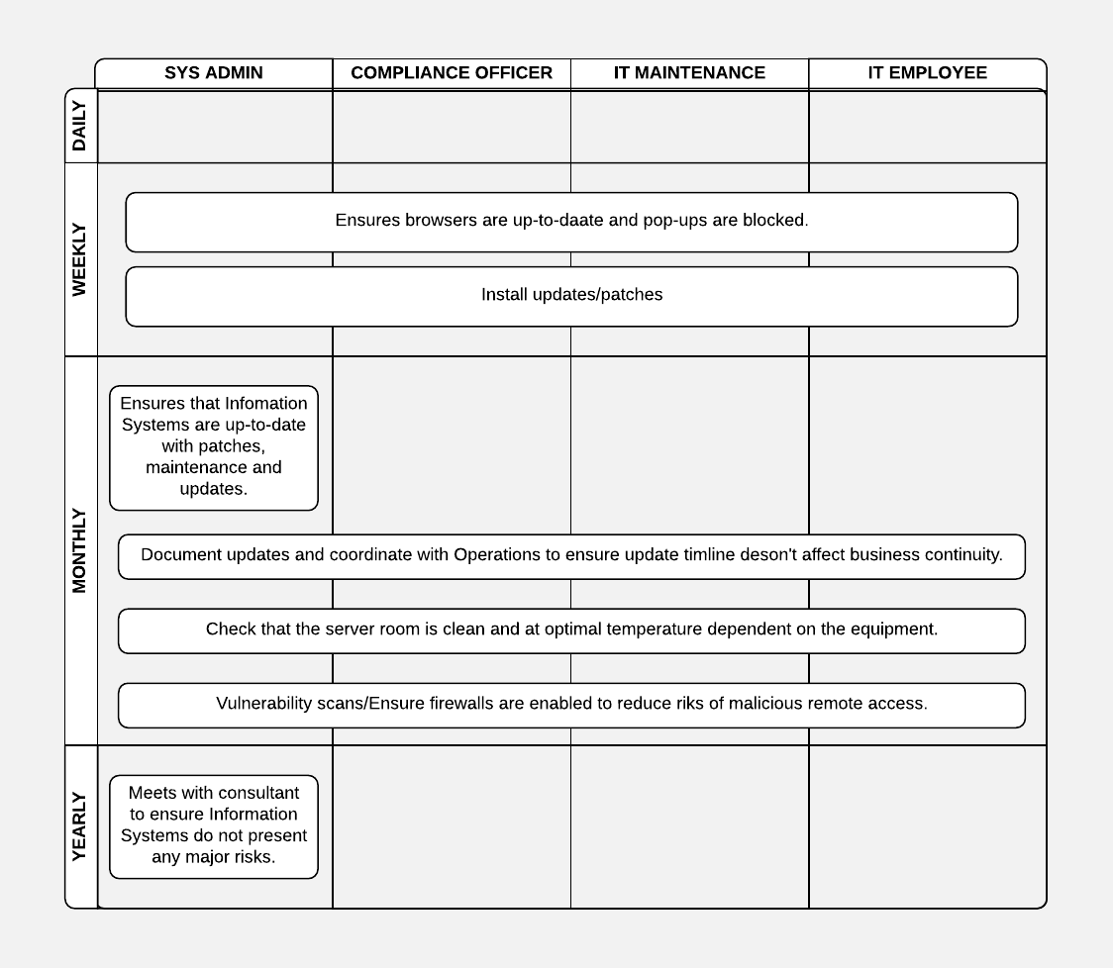
Protection from Malicious Software
Walkthrough
IT manager (specific employee, Operations maybe?) combs through monthly to ensure Information Systems are up-to-date with patches/maintenance/updates
IT manager meets with consultant to ensure Information Systems do not present any major risks
Document any updates and coordinate with operations to ensure update timeline does not affect business continuity
Penetration testing in safe environment before update is pushed to production
Install updates/patches
Post update/patch review that all use cases operate effectively
Verify user access is still in place
Employees can only access proper PHI related tasks for their respective job
IT staff ensures (remotely) browers are up-to-date & pop-ups are blocked
Browers do not store passwords
Safari: java is disabled
Monthly vulnerability scans of systems containing ePHI from (IT Ops Manager)
Monthly ensure firewalls are enabled to reduce risk of malicious remote access
Ensure intrusion detection is functioning properly by penetration testing it and violating the privileges

Slide 36
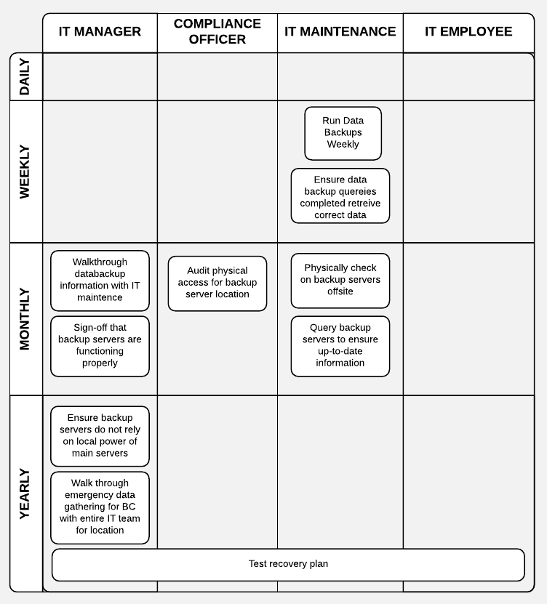
Data Backup Plan
Walkthrough
Backups on all ePHI is completely on a weekly basis
Compliance Officer signs-off along with data analyst to ensure backups are indeed the correct information stored
Verify Backup servers are running
Copies of all backups is stored in a offsite location, secure and undisclosed to public
Backups containing PHI are transported using a secure vendor (BRINKS, etc.)
Documentation that any transported PHI arrived at destination securely from vendor.

Slide 37
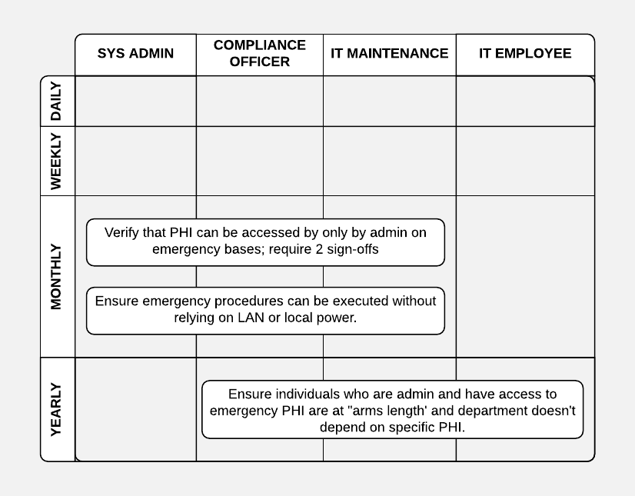
Emergency Access Procedure
Walkthrough
Verify monthly that PHI can be accessed by only the Administrators on an emergency basis
Additionally it should require 2 administrator sign-offs for respective IS to access emergency PHI
The emergency process should be distributed to all relevant employees if changed
Monthly, ensure emergency procedures can be executed without relying on Local Area Network or local power (in case of a business incident)
Yearly, ensure individuals who are administrators and have access to emergency PHI are at “arms length” and their department does not depend on that specific PHI.

Slide 38
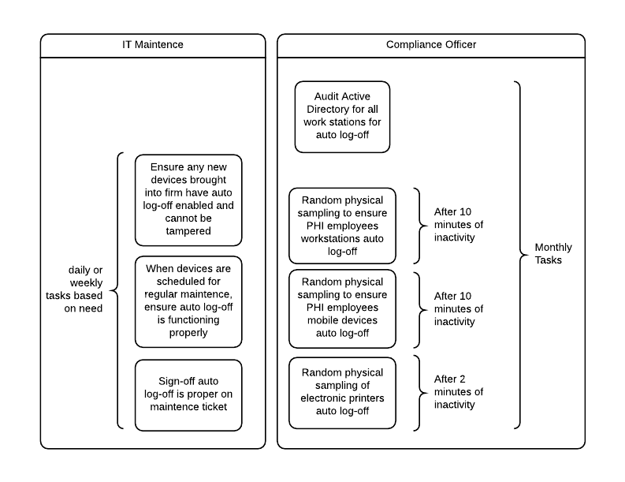
Automatic Log-Off Procedure
Walkthrough
Audit Active Directory every 6 months for automatic logoff is in place
HIPAA compliance officer chooses random employee with access to PHI and ensures their workstation automatically logs off after 10 minutes
Compliance officer chooses random employee to ensure any mobile devices automatically log off after 10 minutes
Compliance officer ensures random printer has auto log off after 2 minutes of inactivity

Slide 39
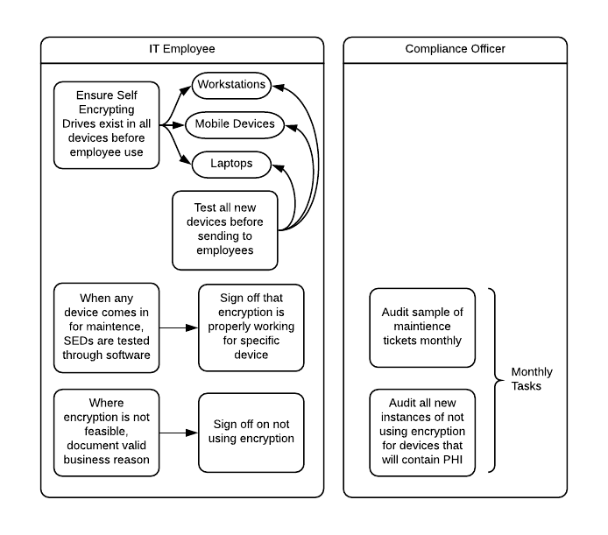
Encryption and Decryption
Walkthrough
To ensure encryption of all ePHI:
Refer back to Disposal (all devices use SEDs – Self encrypting drives)
Cannot be turned off
IT employee ensures each encrypting drive works properly before its assignment to an employee
Laptops
Workstations
Mobile Devices
When routine maintenance is completed on any device, encryption is tested
Where encryption is not feasible to implement:
Printers have fast auto-log off time
There must be a sound business reason encryption is not being used
Confirm with IT encryption is not possible

Slide 40
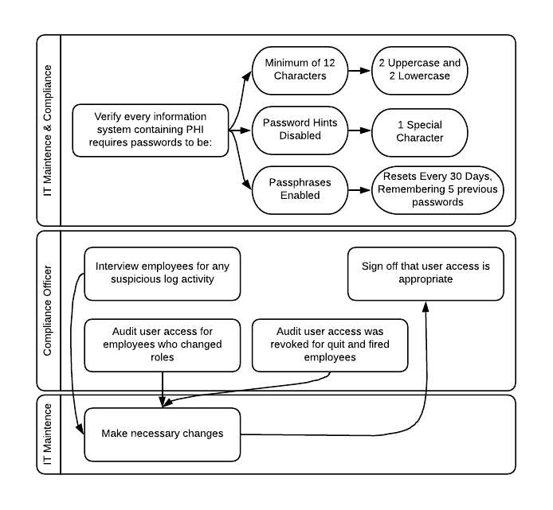
Person or Entity Authentication
Walkthrough
Built in as part of the user access audit
Look for suspicious activity on the user access logs
Interview employees to verify their actual activity
Verify in each Information System that password parameters match the following
Minimum of 12 characters
No password hints
Enable passphrases
2 uppercase & lowercase characters
1 special character
Resets every 30 days
Compliance officer informs employees Passwords are not written down
Review employees who have recently changes roles and ensure their old access was revoked as needed

Slide 41
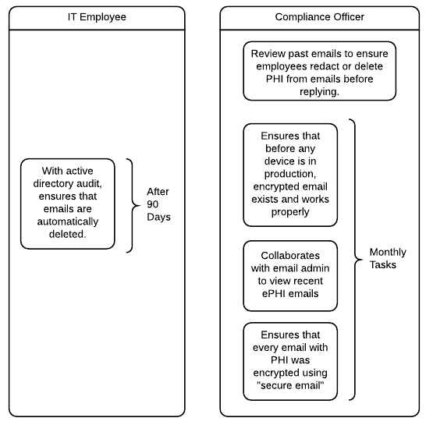
Integrity Controls
Walkthrough
HIPAA compliance officer collaborates with email administrator to view recent ePHI emails and ensure that every email with PHI was encrypted using “secure email”
Ensure before any device is in production, encrypted email exists and works properly
With active directory audit, ensure emails are automatically deleted after 90 days
Review past emails to ensure employees redact or delete ePHI from body of emails before replying to it.

